Slide 1
Name:Bhargavram
Purpose of Presentation:Data analythics Project Presentation
Plat form based presentation:Tableau Dash board on Understanding product data
Domain:Retail and Finance Domain
By
BOARD INFINITY

Slide 2
DATA QUESTIONS
1.What are the sales target
2.What is the profit gained
3.What is the top 3 product sales
4.Which product got more profit
5.Which became more popular from all the products

Slide 3
we are going to analyze and develop a dashboard to understand the product data. Use filters, parameters and actions wherever possible to make the dashboard interactive.
1.Create an interactive map to analyze the worldwide sales and profit. Include map layers and map styles to enhance the visualization. •
2. Create a filter to display top 3 products under top 3 segments.
3. Interactive analysis to display the average gross sales of a product under each segment, allowing only one segment data to be displayed at once.
4. Use customized shapes to visualize product related data in a scatter plot chart.
5.Create a motion chart to compare the sales and profit through the years.
6. Annotate the day wise profit line chart to indicate the peaks and also enable drop lines. 7.Add a reference line to display the average sales line with 50% confidence interval for a bar chart with country, segment wise sales. Create a dynamic parameter to allow user’ to decide the percentage of confidence interval.
8. Add go to URL actions in the final dashboard which directs the user to the respective countries Wikipedia page
9. Include images or logos in the dashboard which is linked to a website.
10.Create phone and tablet layouts to enable mobility of the dashboard.
11. Create a box plot chart to find the outliers in every country.
12. Use set actions to create a proportional brushing for segment wise products

Slide 4
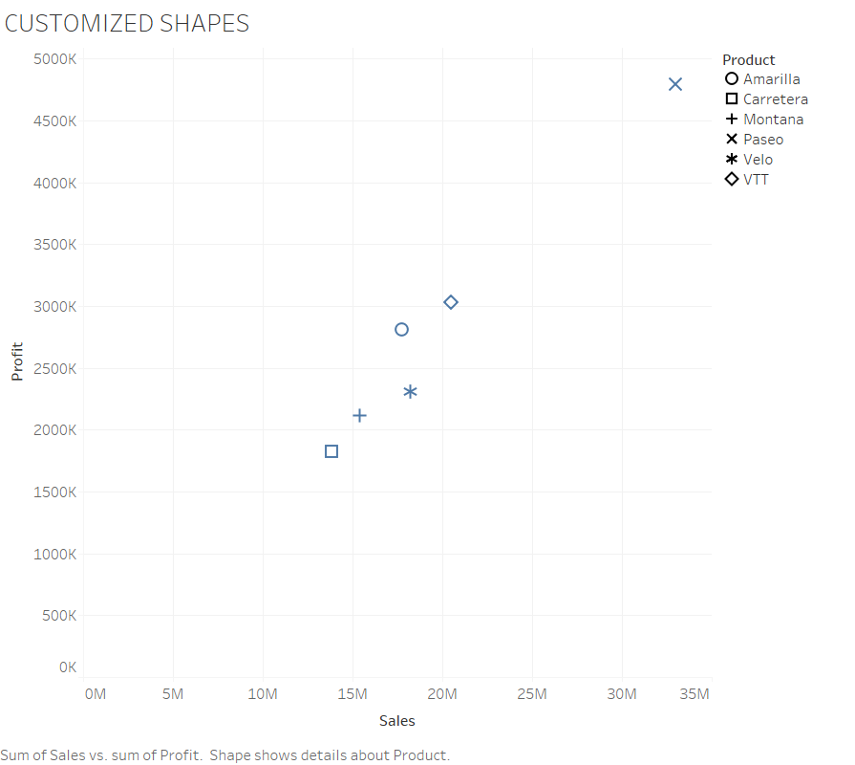

Slide 5
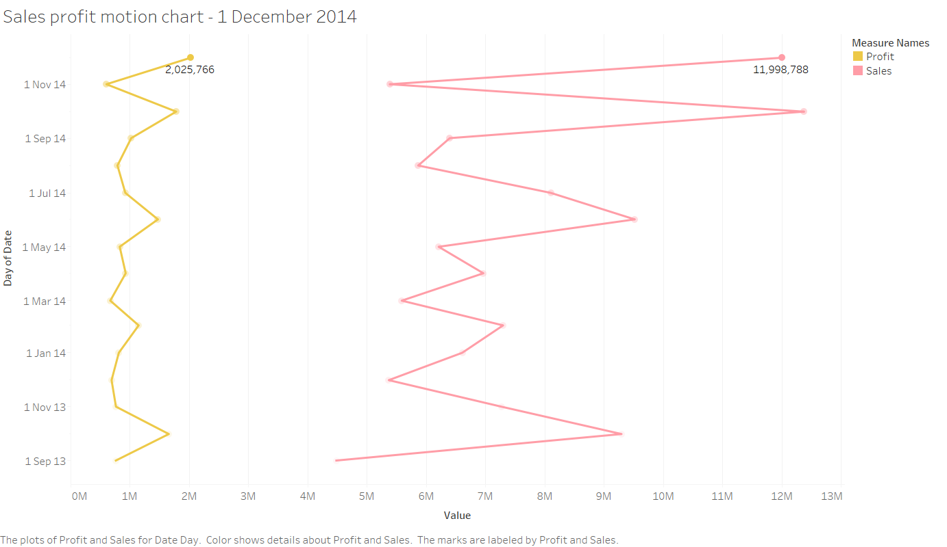

Slide 6
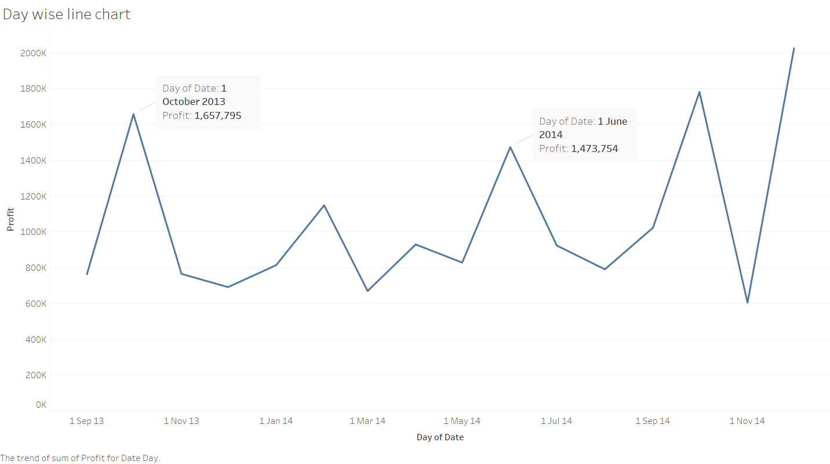

Slide 7
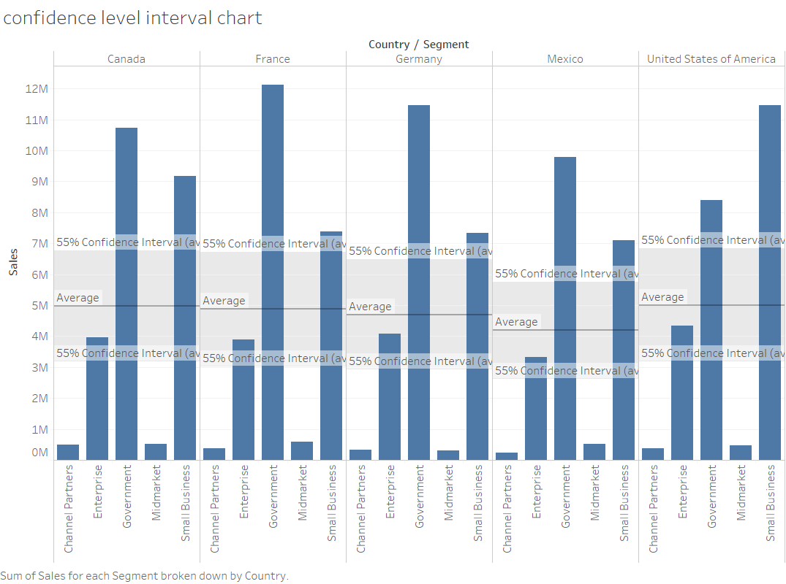

Slide 8
